Slide 1
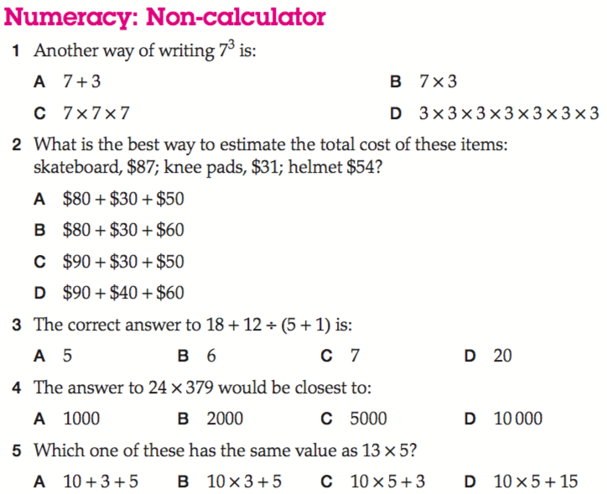
Naplan Starter Questions

Slide 2
My Numbers and Operations Interactive Notebook
$$+$$
$$23$$
-1
$$−$$
$$×$$
$$÷$$
Name:
Class:
Teacher:
Semester 1
Term 1
$$5^{2}$$
$$0$$
$$−10$$

Slide 3

Interactive Notebooks!
Cover Page
Contents Page
Glossary
24/7/30
EQ
Questions
Notes
Summaries
Work page
Presentation!!!
Your book, your responsibility!

Slide 4


Slide 5
Contents
Glossary or Formula Page
Page
Date
Description
2
3

Slide 6

Learning Intentions
To learn a bit about the history of number systems✓
To further expand and solidify our mathematical vocabulary✓
To further learn the value of the place system ✓
To compare, order, add and subtract integers✓
WICOR

Slide 7
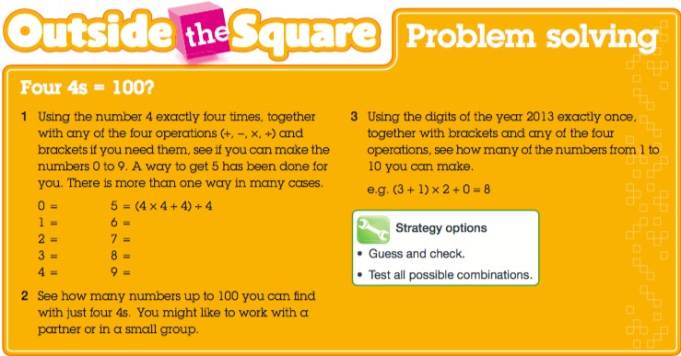

Slide 8

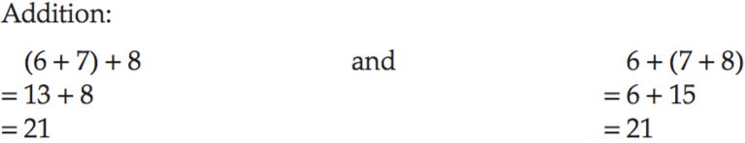
24
7
30
Mental Strategies and Order of Operations Review
Date
EQ – What are some mental strategies we use to solve problems?
We’re going to cover some useful strategies for doing calculations in your head
Strategy 1 – Make easy numbers. This strategy uses two properties of numbers:
The order in which you add or multiply any two numbers does not change the result
This is known as the commutative law.
The order in which three or more numbers are added or multiplied is not
important.

Slide 9
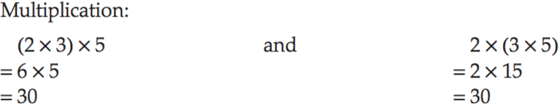
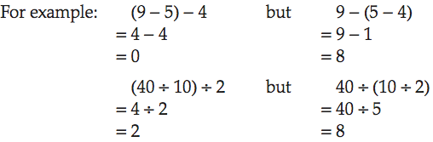
24
7
30
Mental Strategies and Order of Operations Review
Date
EQ – What are some mental strategies we use to solve problems?
This is known as the associative law.
Important note: The commutative and associative laws DO NOT apply to subtraction and division.

Slide 10

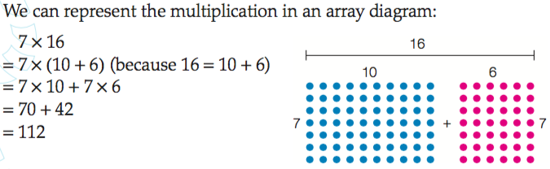
24
7
30
Mental Strategies and Order of Operations Review
Date
EQ – What are some mental strategies we use to solve problems?
These laws come in handy because multiples of 10 are easy to add and multiply.
Strategy 2 – Use the distributive law. This law allows us to multiply a large number by splitting it into 10s and 1s (or 100s, 10s, 1s)

Slide 11
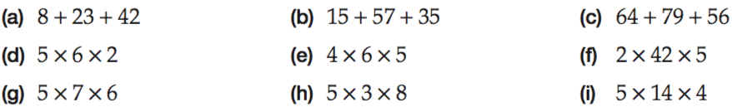
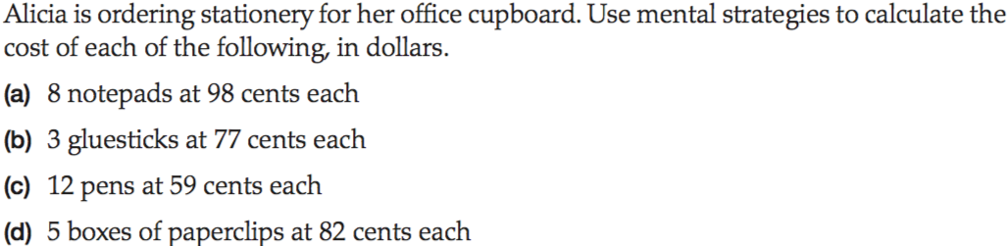

Slide 12

Do you understand? Fists of Five
Notes:
Check for Understanding

Slide 13
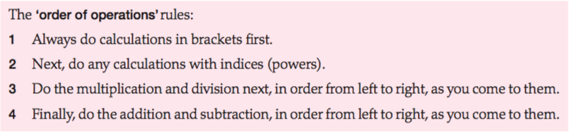
24
7
30
Mental Strategies and Order of Operations Review
Date
EQ – What are some mental strategies we use to solve problems?
Earlier we learned about Order of Operations.
Order of Operations are needed to figure out the correct answer to questions involving multiple operations.
Ex: 1+ 2 x 3 + 4 Can have three answers: 11, 13 and 15. Which one is correct?
Remember these rules:

Slide 14
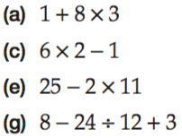
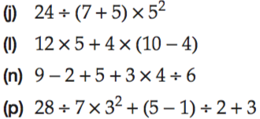

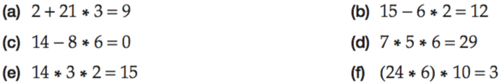
Your Turn

Slide 15
Classwork/Homework
The operation theatre
worksheet

